Slide 1


Slide 2
Department of Computer
Science
GLA UNIVERSITY
GLA University ,
Mathura-281406
19 JANUARY 2023
Submitted to:-
Sunil Kumar
Submitted by:-
PROJECT GUIDE
Luvya Sharma ,73
Muskan gupta,38
Mohit Krishna Kaushik,37
Naresh
Singh,39
Mayank Singh,36

Slide 3
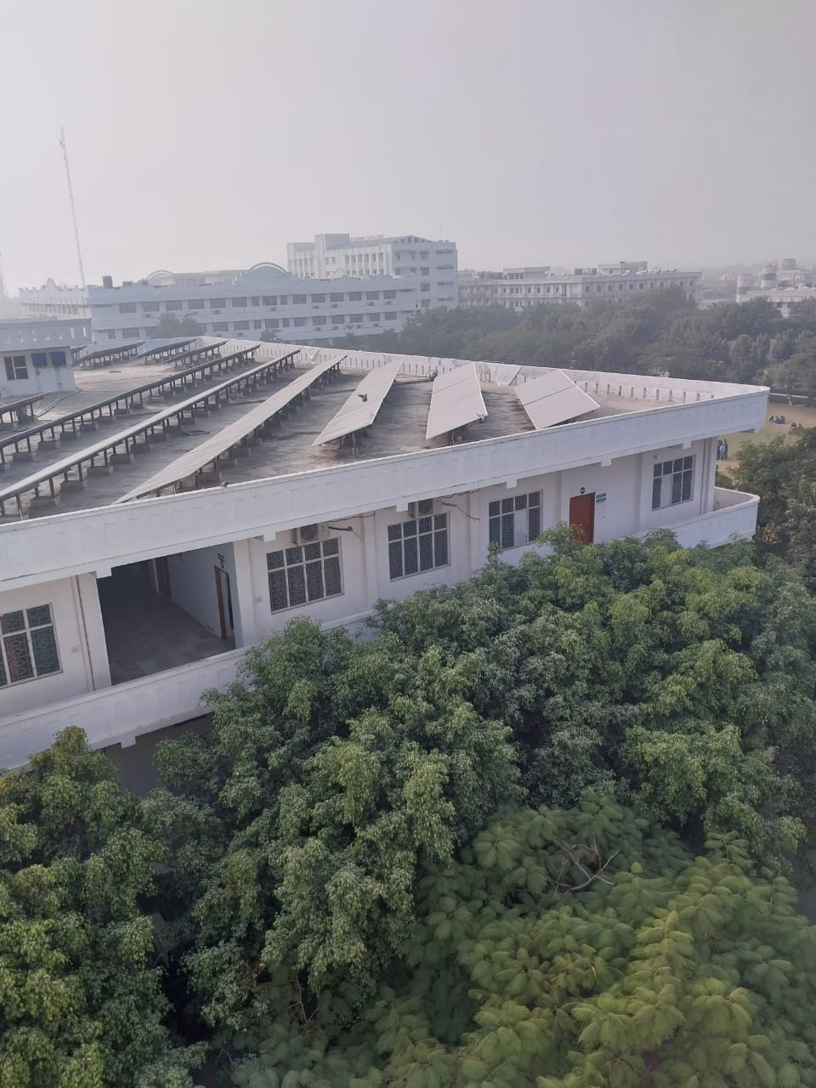
AGENDA
. LAYOUT OF GLA
. TO KNOW ABOUT LAYOUT
. TYPES OF LAYOUT
. AREA OF IMPROVEMENT IN
LAYOUT OF GLA

Slide 4
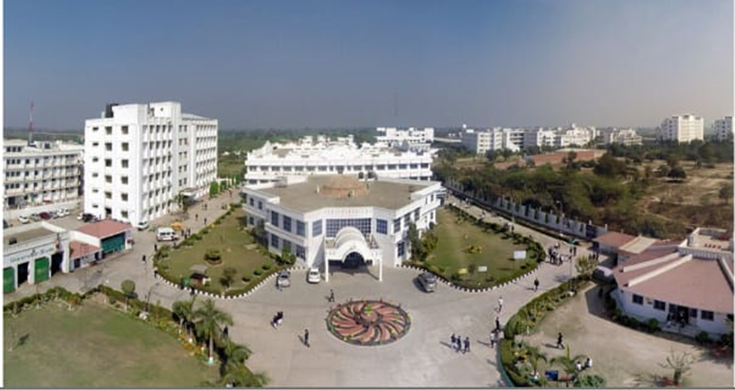
LAYOUT OF GLA UNIVERSITY
University layout is designed to create a pleasant and stimulating environment for student and staffs. The layout focuses on the use of open space and natural element to create a welcoming atmosphere . The main campus is organized in four main section: The Academic Zone, The Administrative Zone ,The Student Service Zone and The Residential Zone.

Slide 5
WHAT IS A LAYOUT ?
A LAYOUT OF A BUILDING OR A STRUCTURE SHOWS THE PLANS
OF ITS FOUNDATION ON THE GROUND SURFACE ACCORDING
TO ITS DRAWING, SO THAT EXCAVATION CAN BE CARRIED OUT
EXACTLY WHERE REQUIRED AND REQUIRED AND POSITION
AND ORIENTATION OF THE BUILDING IS EXACTLY SPECIFIED

Slide 6
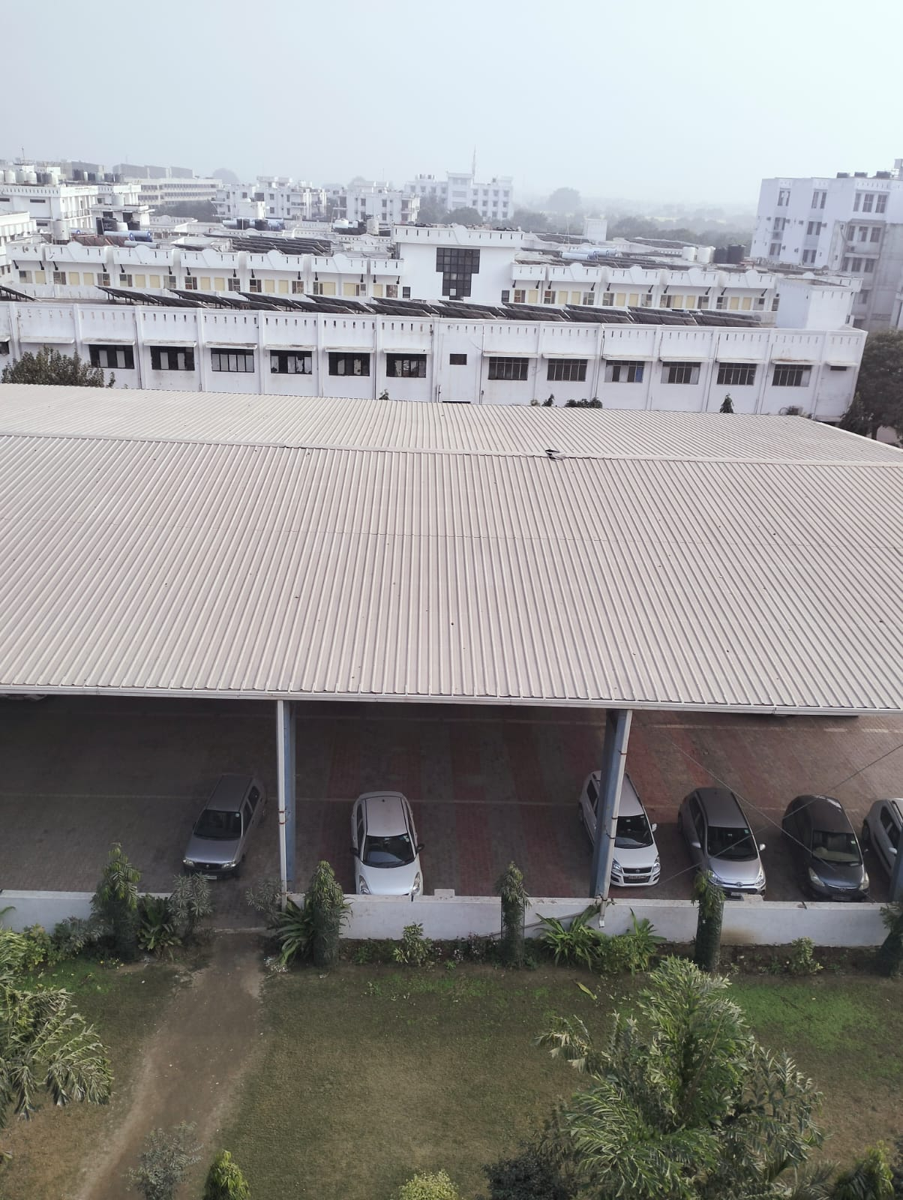
CHARACTERISTICS OF A GOOD LAYOUT
Efficient Space Utilization
Economy In Handling
Minimum Movement
Accessibility
Reduction Of Discomfort
Preservation Of Material And Equipment

Slide 7
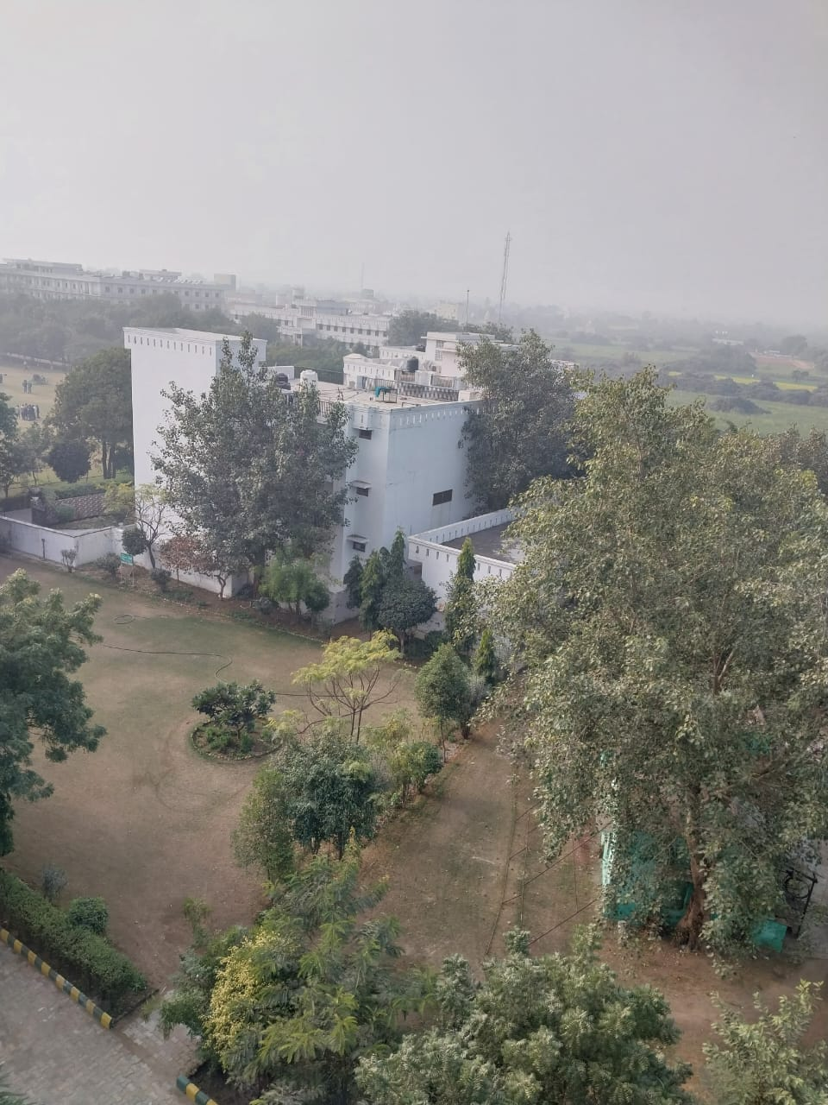
TYPES OF LAYOUT
Fixed Layout
Responsive Layout
Grid Layout
Hierarchical Layout
Magazine Layout
Adaptive Layout

Slide 8
FIXED LAYOUT
A fixed layout is a design that has a predefined structure and does not change. It is typically used for print documents and websites that are viewed on desktop computers.

Slide 9
RESPONSIVE LAYOUT
A responsive layout is a design that adjusts to different screen sizes and orientations. It is often used to create mobile-friendly websites.

Slide 10
COMBINATION LAYOUT
The advantages of both kinds of layout are combined in a process and product layout are combined in a process and product layout . A combination layout is possible when an item is manufactured in multiple types and sizes.

Slide 11
GRID LAYOUT
A grid layout is a design that uses a grid structure to arrange elements. It is often used to create a visual hierarchy, organize content, and create a unified design.

Slide 12
HIERARCHICAL LAYOUT
A hierarchical layout is a design that arranges elements in a hierarchy. It is often used to organize content and create a visual hierarchy.

Slide 13
MAGAZINE LAYOUT
A magazine layout is a design that arranges elements according to a grid structure. It is often used to create a visual hierarchy and organize content for magazine pages.

Slide 14
ADAPTIVE LAYOUT
An adaptive layout is a design that changes based on the user’s interaction with the content. It is often used to create more interactive experiences.

Slide 15
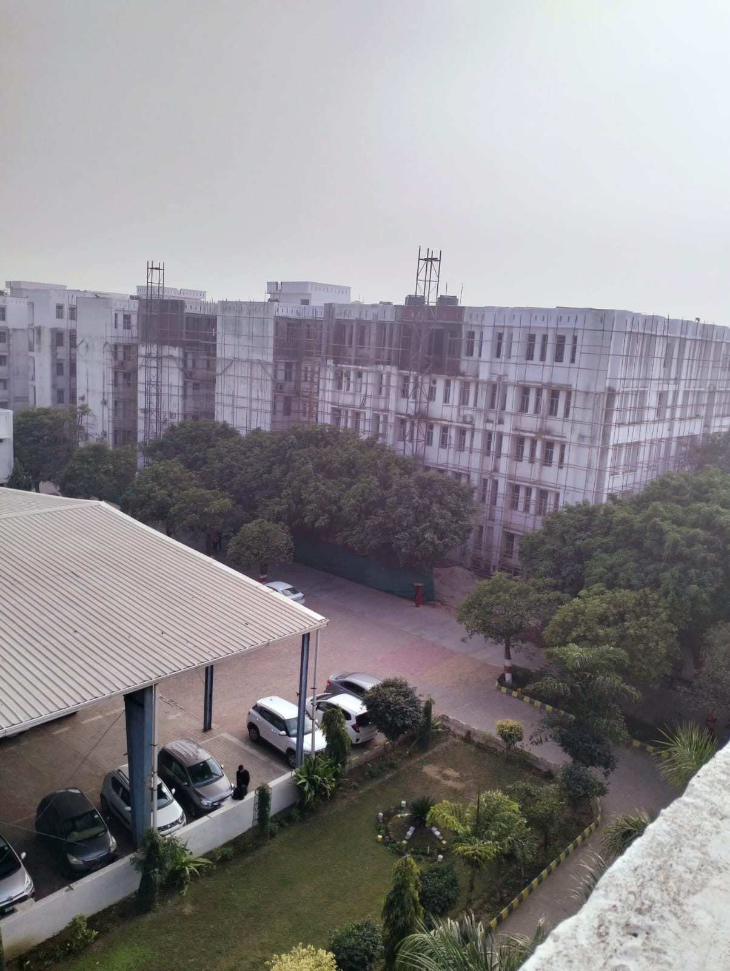

AREA OF IMPROVEMENT
INCREASE LENGTH OF GROUNDS
BUILD A BALCONY IN TRIPLE OCCUPENCY IN HOSTEL
INCREASE NO OF LIFTS OR CAPACITY OF LIFTS IN ACADEMIC BLOCK 7 AND 8
INCREASE THE NO OF BATHROOMS IN ACADEMIC BLOCK
IMPROVE IN MATERIAL QUALITY OF BUILDINGS(HOSTELS,ACADEMIC BLOCKS,LABS ETC.)
IMPROVEMENT IN THE QUALITY OF SYSTEMS IN LAB

Slide 16

Improve the aesthetics of the campus.
Install more bike racks.
Improve the accessibility of the University to make it easer for student and staffs to move around the campus.

Slide 17
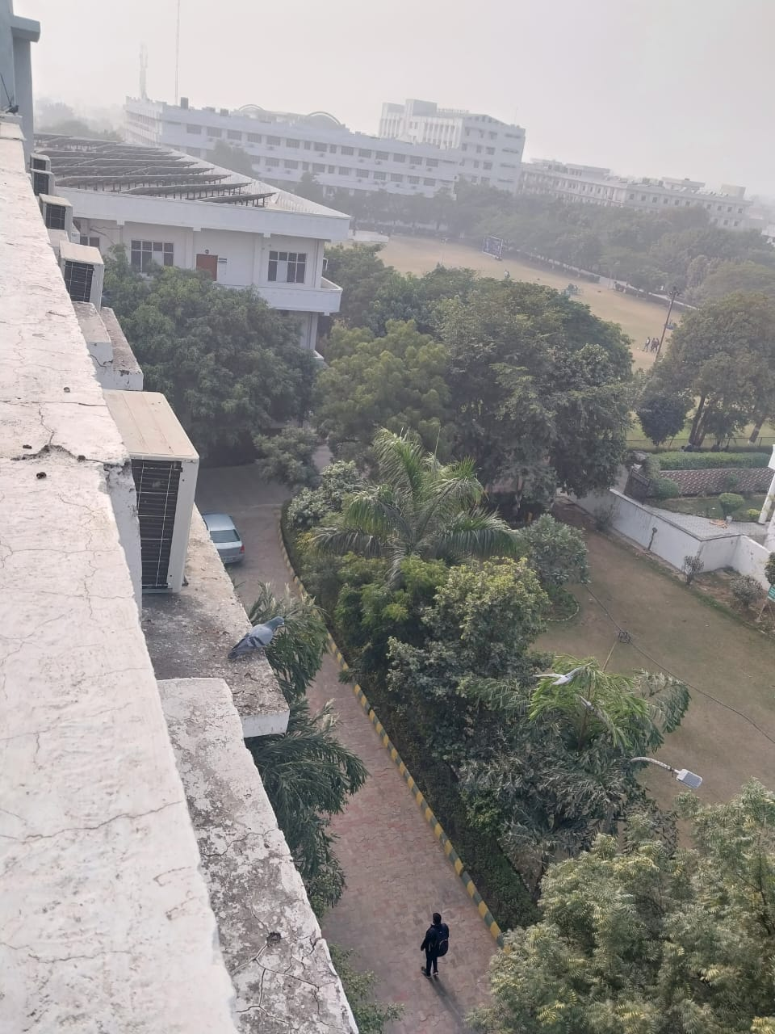
THANK YOU

